Slide 1
Building Suffix Array Program
Using C++ and Java Program Language

Slide 2
Hello!
💃
🏃
ANDREAN AHMAD FAUZI
Dimas Arya Kusuma Putra
Alifiano Rifqi Athallah
💃

Slide 3

SUFFIX ARRAY
Brief Explanation of
Suffix array is data structures that are designed for optimize and streamline search in big text.

Slide 4
Let’s Analysis

Slide 5
S E K O L A H
We use “SEKOLAH” word for the sample text. Sample text is, text wich we want search the suffix.

Slide 6

Step 1
Assign “Index Point" To the Sample Text
The point index determines the position so that a search can be performed. In this case, the point index is paired on character by character.

Slide 7
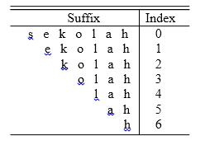
Step 2
Sort the “Index Points” Based on Each Corresponding Suffix
Seperate index point and sort each corresponding suffix.

Slide 8
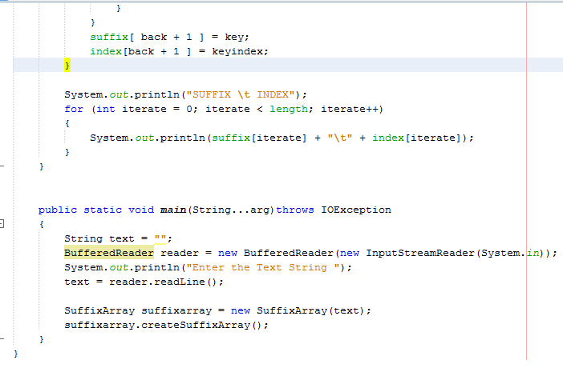
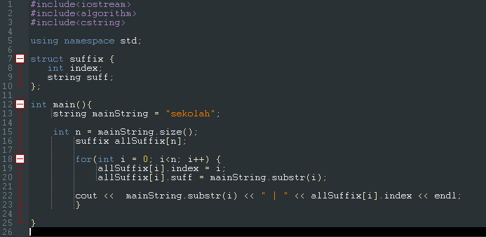
Step 2 : Code
Sort the “Index Points” Based on Each Corresponding Suffix
C++
Java
Let’s see in line 15 until 20. In line 15 until 16, that’s code for convert from sample text to suffix. Then, in line 19 until 20 is code for give the suffix index. The result in image below.
This code in Java

Slide 9
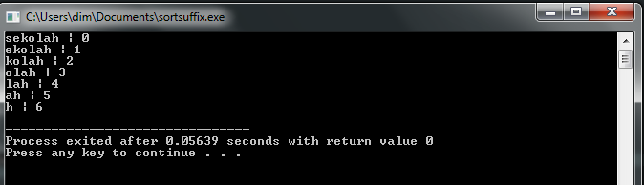
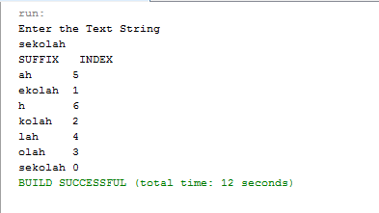
Step 2 : Result
Sort the “Index Points” Based on Each Corresponding Suffix
C++
Java
Result
Result

Slide 10
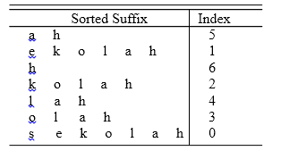
Step 3
Sort The Suffix In Alphabetical Order
After the suffix has been sorted, the suffix array from the "sekolah" sample is visible.

Slide 11
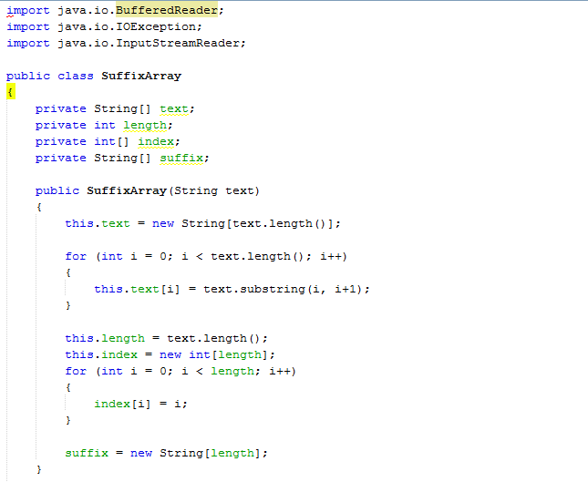
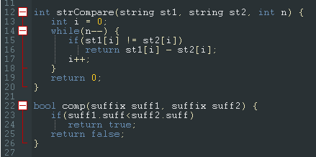
Step 3 : Code
Sort the “Index Points” Based on Each Corresponding Suffix
C++
Java
For sorting the suffix, create code for compare before the string. Readers can see the code in image below. Put this code before “int main(){...}”
For sorting the suffix, create code for compare before the string.

Slide 12
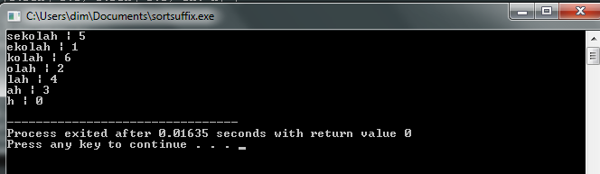
Step 3 : Result
Sort the “Index Points” Based on Each Corresponding Suffix
C++
Java
Result
Result

Slide 13
Step 4
Final Result
7 $
5 ah$
1 ekolah$
6 h$
2 kolah$
4 lah$
3 olah$
0 sekolah$
The index results from suffix sequencing become suffix arrays for "sekolah" sample text. This sorting index will later become the suffix array.
Usually a text will be said to end if there is a marker. In this case, the marker is a symbol. The symbol usually used is "$". The addition of this symbol will affect the length of the text.
By including the symbol "$" as a suffix, the sample text will become "sekolah$".
So, the suffix array for the "sekolah" text example above is {7,5,1,6,2,4,3,0}.

Slide 14
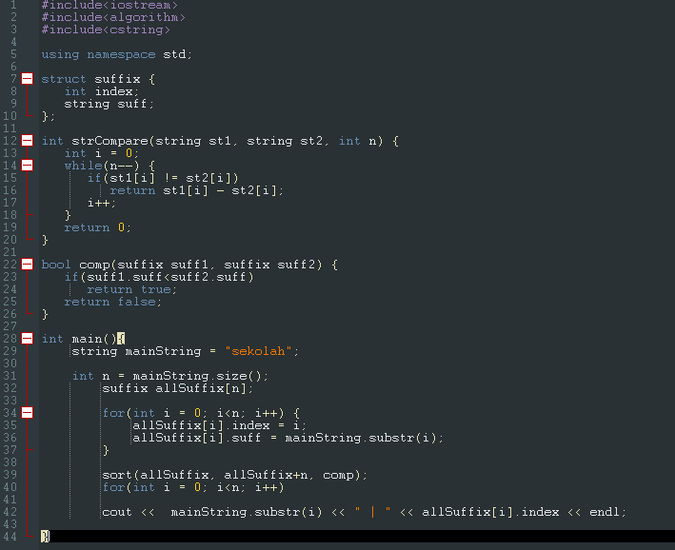
Step 4 : Code
Result
C++
Java

Slide 15
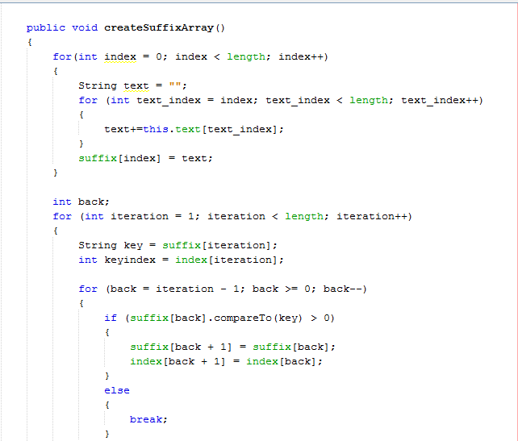
Step 4 : Code
Result
C++
Java

Slide 16
Step 4 : Code
Result
C++
Java

Slide 17
Step 4 : Result
Result
C++
Java
Result
Result

Slide 18
Implementation Suffix Array

Slide 19
Suffix array usually used for string matching problem. And can be used in biological research.

Slide 20
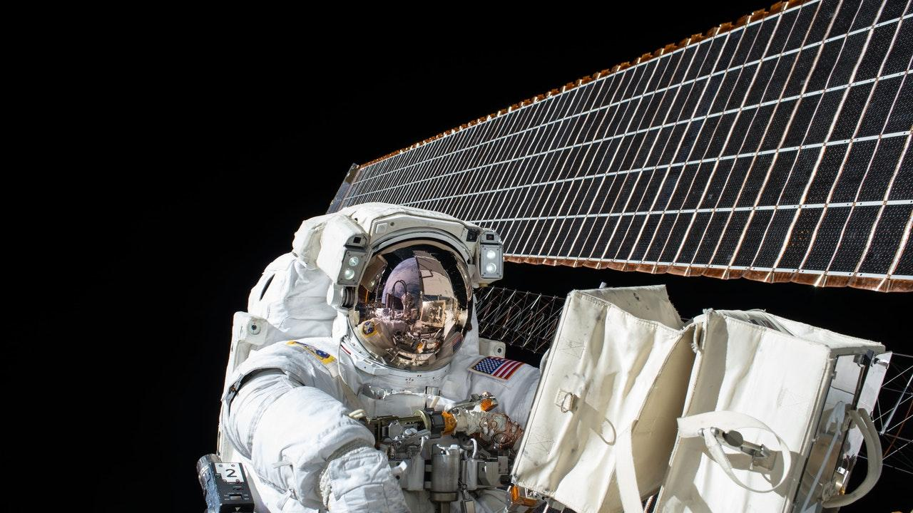
Thanks!!

